Slide 1
Microsoft® Office
Training
Seamon,Whiteside & Associates presents:
Get up to speed with the
2007 system
Notes:
[Notes to trainer:
For detailed help in customizing this template, see the very last slide. Also, look for additional lesson text in the notes pane of some slides.
Because this presentation contains Macromedia Flash animations, saving the template may cause a warning message to appear regarding personal information. Unless you add information to the properties of the Flash file itself, this warning does not apply to this presentation. Click OK on the message.]

Slide 2

Overview: A new look to familiar programs
When you open a 2007 Microsoft Office system program, you’ll see a lot that’s familiar. But you’ll also notice a new look at the top of the window.
Menus and toolbars have been replaced by the Ribbon, which contains tabs that you click to get to commands.
This presentation introduces you to the Ribbon and other new ways to make better documents, faster.
Get up to speed with the 2007 Office system
Notes:
Notes:
Microsoft Office programs described in this training presentation include Microsoft Office Word 2007, Office Excel® 2007, Office PowerPoint® 2007, Office Access 2007, and Office Outlook® 2007.
The Ribbon was developed in response to what Office users—possibly you—have asked for: programs that are simpler to use, with commands that are easier to find. The Ribbon may be new, but with a little time and exposure you’ll find that it works for you, not against you.

Slide 3
Lesson 1
The new Office: Made for you

Slide 4
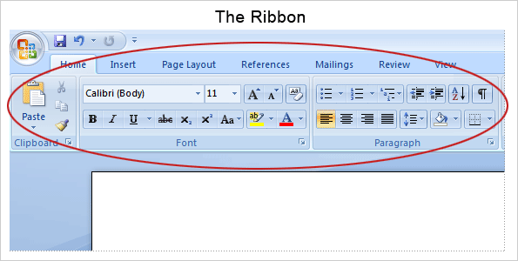
The new Office: Made for you
Yes, there’s a lot of change to familiar Microsoft Office programs.
But it’s good change.
With the Ribbon, commands and other tools you need are now exposed and more readily available.
Get up to speed with the 2007 Office system
Notes:
Instead of having 30 or so undisplayed toolbars, and commands buried on menus or in dialog boxes, you now have one control center that brings the essentials together and makes them very visual.
And once you learn how to use the Ribbon in one program (the picture here shows Word 2007), you’ll find it easy to use in other programs too.

Slide 5
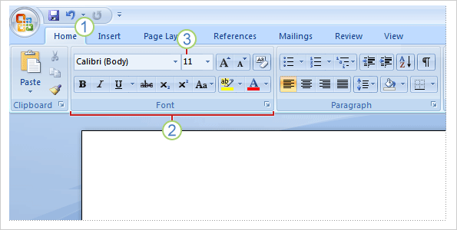



What’s on the Ribbon?
The three parts of the Ribbon are tabs, groups, and commands.
Tabs sit across the top of the Ribbon. Each one represents core tasks you do in a given program.
Groups are sets of related commands. They remain on display and readily available, giving you rich visual aids.
Commands are arranged in groups. A command can be a button, a menu, or a box where you enter information.
Get up to speed with the 2007 Office system

Slide 6
What’s on the Ribbon?
How do you get started?
Begin with the first tab.
In Word 2007, for example, that’s the Home tab.
It’s got the commands that people use most commonly when they write documents: font formatting commands (Font group), paragraph options (Paragraph group), and text styles (Styles group).
Get up to speed with the 2007 Office system
Notes:
You’ll find the same organization in other 2007 Office system programs, with the first tab including commands for the most key type of work. The primary tab in Excel, PowerPoint, and Access is also the Home tab. In Outlook, when you create a message, it’s the Message tab.

Slide 7
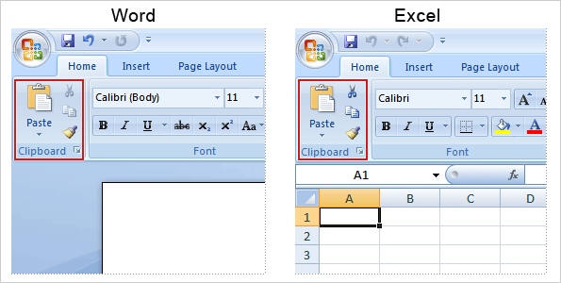
How commands are organized
Commands are organized by how they’re used.
Frequently used core commands no longer have to share space with a range of remotely related commands on a menu or toolbar.
They’re the ones that get used, and so now they’re the ones most prominently featured.
Get up to speed with the 2007 Office system
Notes:
Take the Paste command, for example. It’s one of the most frequently used commands. Why not give it maximum exposure in the window, along with its related commands, Cut and Copy? In Word and Excel, these commands all appear on the Home tab.
Less frequently used commands are less prominent on the Ribbon. For example, most people use Paste Special less often than they use Paste. So to access Paste Special, you first click the arrow on Paste.

Slide 8
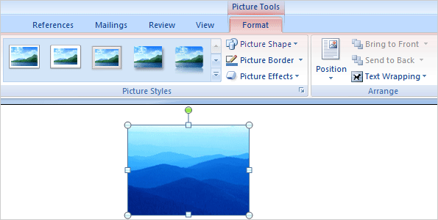
More commands, but only when you need them
Commands you use most are available on the Ribbon all the time.
Others appear only when you need them, in response to an action you take.
For example, the Picture Tools in Word appear on the Ribbon when you insert a picture, and they go away when you’re done. The Ribbon responds to your action.
So don’t worry if you don’t see all the commands at all times. Take the first steps, and what you need will appear.
Get up to speed with the 2007 Office system
Notes:
If you don’t have a picture in your Word document, the commands to work with a picture aren’t necessary. But after you insert a picture in Word, the Picture Tools appear along with the Format tab that contains the commands you need to work with the picture.
When you’re through working with the picture, Picture Tools go away. If you want to work on the picture again, just click it, and the tab appears again with all the commands you need.

Slide 9
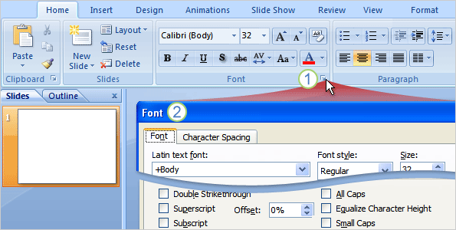
More options if you need them
Sometimes an arrow, called the Dialog Box Launcher, appears in the lower-right corner of a group.
This means more options are available for the group.
For example, to get to a less commonly used font option in PowerPoint® 2007:
On the Home tab, click the arrow in the Font group.
The Font dialog box opens, with the full selection of font commands.
Get up to speed with the 2007 Office system
Notes:
In PowerPoint, the example described here, the Font group on the Home tab contains all the commands that are used the most to make font changes: commands to change the font face and font size, and to make the font bold, italic, or underlined.
Clicking the Dialog Box Launcher gets you to all the other, less commonly used options such as superscript.

Slide 10
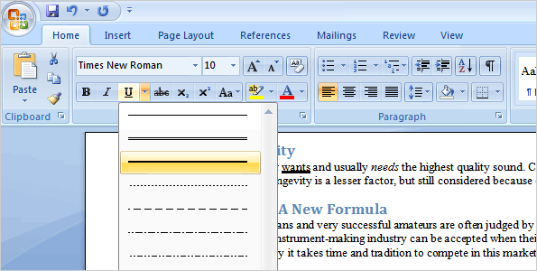
Preview before you select
Are you familiar with the try-undo-try cycle?
You make a change, it’s not what you want, and so you undo and keep trying until you get what you had in mind.
Now you can see a live preview of your choice before you make a selection, which saves you time and gives you better results.
Get up to speed with the 2007 Office system
Notes:
Try-undo-try. You select a font, font color, or style, or make changes to a picture. But the option you select turns out not to be what you want, so you undo and try again, and perhaps again, until you finally get what you have in mind.
To use live preview, rest the mouse pointer on an option. As the picture shows, your document changes to show you what that option would look like, before you actually make a selection. After you see the preview of what you want, then you click the option to make your selection.
[Note to trainer: This slide is identical to the preceding slide except that it has static art instead of an animation. Use this slide if you have problems viewing the animation. Delete either the current slide or the preceding slide before showing the presentation.]

Slide 11
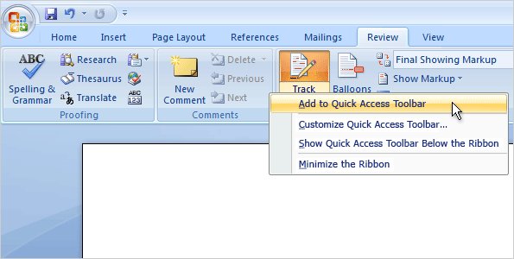
Put commands on your own toolbar
Do you often use commands that aren’t as quickly available as you’d like?
You can easily add them to the Quick Access Toolbar.
Located above the Ribbon when you first start your Microsoft Office program, the Quick Access Toolbar puts commands where they’re always visible and near at hand.
Get up to speed with the 2007 Office system
Notes:
For example, if you use Track Changes in Word or Excel every day to turn on revision marks, and you don’t want to have to click the Review tab to access that command each time, you can add Track Changes to the Quick Access Toolbar.
To do that, right-click Track Changes on the Review tab, and then click Add to Quick Access Toolbar. To delete a button, right-click it, and then click Remove from Quick Access Toolbar.
[Note to trainer: This slide is identical to the preceding slide except that it has static art instead of an animation. Use this slide if you have problems viewing the animation. Delete either the current slide or the preceding slide before showing the presentation.]

Slide 12
Lesson 2
Answers to critical questions

Slide 13
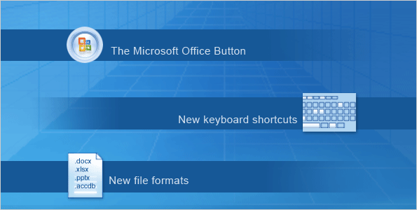
Answers to critical questions
Now it’s time to look beyond the Ribbon and see what else is new.
The Microsoft Office Button is new, as are new keyboard shortcuts and new file formats for Word, Excel, PowerPoint, and Access 2007.
In this lesson, you’ll find out how to work with some of the new options.
Get up to speed with the 2007 Office system
Notes:
The Microsoft Office Button takes the place of the File menu in several Office programs. It provides more options, more conveniently located together.
In this lesson you’ll also find out what to do if you can’t find a command you need, see how to work with the new file formats, and find out how people who haven’t upgraded to Word, Excel, or PowerPoint 2007 can open your files and work in them as usual.

Slide 14
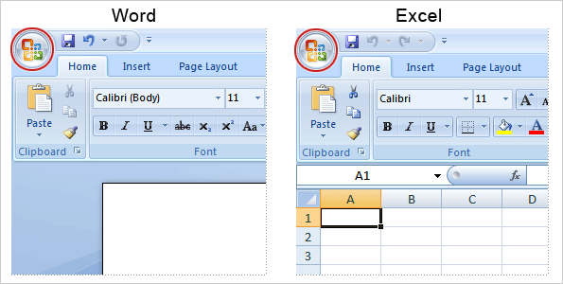
What happened to the File menu?
The Microsoft Office Button appears in the upper-left corner of the window in several Microsoft Office programs, such as Word and Excel.
But the button offers more commands than the File menu did.
Get up to speed with the 2007 Office system
Notes:
For example, you’ve got support here for checking that files in Word, Excel, and PowerPoint don’t contain private information or comments.

Slide 15
What happened to the File menu?
The Microsoft Office Button also leads you to the program settings that control things like your preferences for correcting spelling.
In previous versions of Office programs you could set options in the Options dialog box, which you opened through the Tools menu.
Many of those options can now be found when you click the Microsoft Office Button.
Get up to speed with the 2007 Office system
Notes:
Having program options available through the Microsoft Office Button makes them more visible and conveniently close at hand when you start work on old files or new ones.
Click Excel Options, Word Options, and so on, at the bottom of the menu, and then click any of the categories in the list that appears on the left. For example, in Excel, click Formulas to turn the R1C1 reference style on or off. In Word, click Proofing to turn on or off the feature to check spelling as you type.

Slide 16
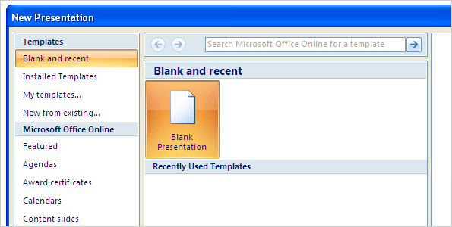
Where do I start a blank document?
When you create a new document, workbook, presentation, or database, you’ll get a full, colorful window to help you begin.
You can start with a blank or existing file, as you’re accustomed to doing.
Or to jump-start your authoring work, look on the left. Under Microsoft Office Online, click Featured, and choose from the catalog of links to online templates and training courses.
Get up to speed with the 2007 Office system
Notes:
To get to the new window, start by clicking the Microsoft Office Button in the upper-left corner of the window. Then click New to open the New Document window in Word, the New Workbook window in Excel, the New Presentation window in PowerPoint, or the Getting Started with Microsoft Office Access window in Access.
The picture shows the New Presentation window in PowerPoint.

Slide 17
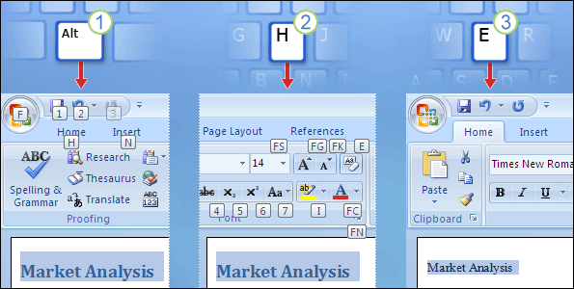
What about favorite keyboard shortcuts?
If you rely on the keyboard more than the mouse, you’ll want to know that the Ribbon design comes with new shortcuts.
This change brings two big advantages over previous versions of Office programs:
There are shortcuts for every single button on the Ribbon.
Shortcuts often require fewer keys.
Get up to speed with the 2007 Office system

Slide 18
What about favorite keyboard shortcuts?
The new shortcuts also have a new name: Key Tips.
The picture shows an example of using Key Tips to remove a heading style in Word.
Press ALT to make the Key Tips appear.
Press H to select the Home tab.
Press E to select the Clear Formatting button in the Font group to remove the heading style.
Get up to speed with the 2007 Office system
Notes:
More on using the new shortcuts
When you press ALT, you’ll see Key Tips for all the Ribbon tabs, all commands on the tabs, the Quick Access Toolbar, and the Microsoft Office Button.
Press the key for the tab you want to display. This makes all the Key Tip badges for that tab’s buttons appear. Then, press the key for the button you want.

Slide 19
What about favorite keyboard shortcuts?
What about the old keyboard shortcuts?
Keyboard shortcuts of old that begin with CTRL are still intact, and you can use them as you always have.
For example, the shortcut CTRL+C still copies something to the clipboard, and the shortcut CTRL+V still pastes something from the clipboard.
Get up to speed with the 2007 Office system
Notes:
To learn more about keyboard shortcuts, see the Quick Reference Card, linked to at the end of this presentation.

Slide 20
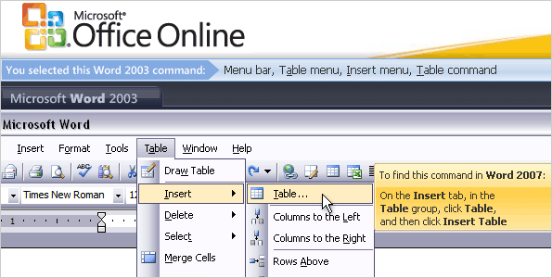
What if I can’t find a command?
If you can’t find the command you’re looking for, there’s help.
For Word 2007, Excel 2007, and PowerPoint 2007, there’s a visual, interactive reference guide to help you quickly learn where things are.
Get up to speed with the 2007 Office system
Notes:
The picture illustrates how to use the interactive guide:
You point to a command in the Office 2003 program to see where it is in the new program. For example, to find the Insert Table command in Word, in the guide you would rest the pointer on the Insert command in Word 2003.
Click to see an animation of the location of the command in Word 2007. (It’s on the Insert tab in the Tables group).
In addition to giving you immediate help, the guides also serve as a learning tool that will help you get familiar with the location of particular commands.
You’ll find the links to these guides in the Quick Reference Card at the end of the course.
[Note to trainer: This slide is identical to the preceding slide except that it has static art instead of an animation. Use this slide if you have problems viewing the animation. Delete either the current slide or the preceding slide before showing the presentation.]

